Slide 1
SKKU Lab Recommendation Service : FindMyLab
Midterm Presentation
Team J (Last Lap) 김현진 송민석 장민석 조재희
2024-Fall Capstone Design Project
Notes:
Hello, my name is minseok song from them j. Today, I will present a midterm update on our project, FindMyLab.

Slide 2
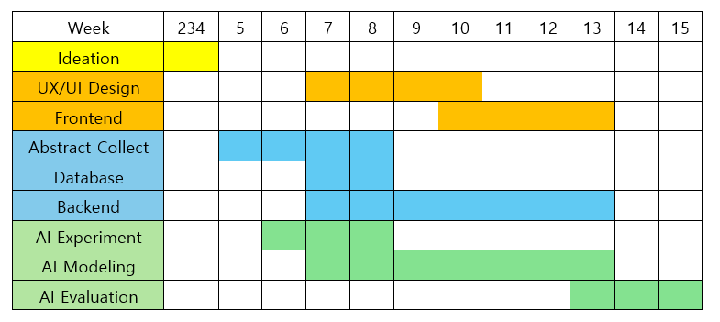
Objectives & Milestones
Midterm Presentation
2024-Fall Capstone Design Project
Team J (Last Lap) 김현진 송민석 장민석 조재희
Notes:
Our project's goal is to develop a program that helps students interested in URP or graduate school to easily find research labs conducting studies in their fields of interest. To achieve this, we have developed the following plan. We have completed the abstract collection and AI experiments, and are currently working on UX/UI design, API documentation, and AI modeling.

Slide 3

Role of each member
MinSeok Jang
HyunJin Kim
MinSeok Song
JaeHee Jo
UX/UI
Front-End
Abstract Extract
Back-End
AI Modeling
2024-Fall Capstone Design Project
Team J (Last Lap) 김현진 송민석 장민석 조재희
Notes:
The roles of each team member are as follows. Jang Min-seok and Kim Hyun-jin are focusing on design and frontend, Song Min-seok is handling the backend, and Jo Jae-hee is leading the AI modeling.

Slide 4
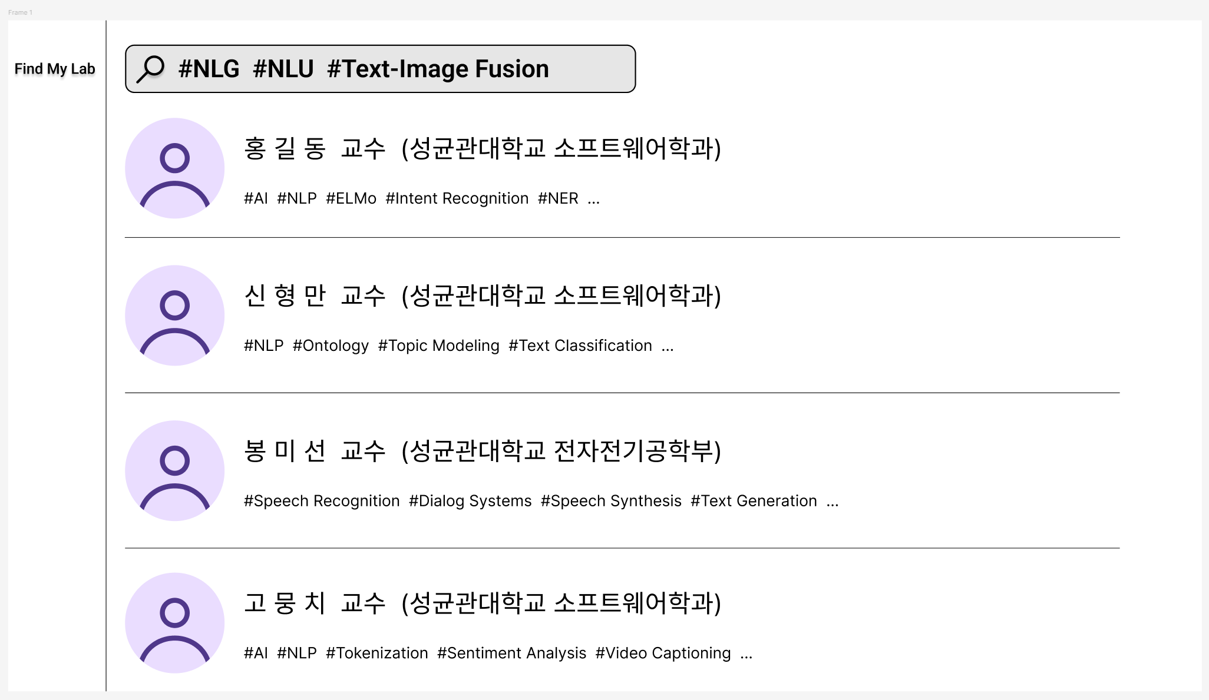
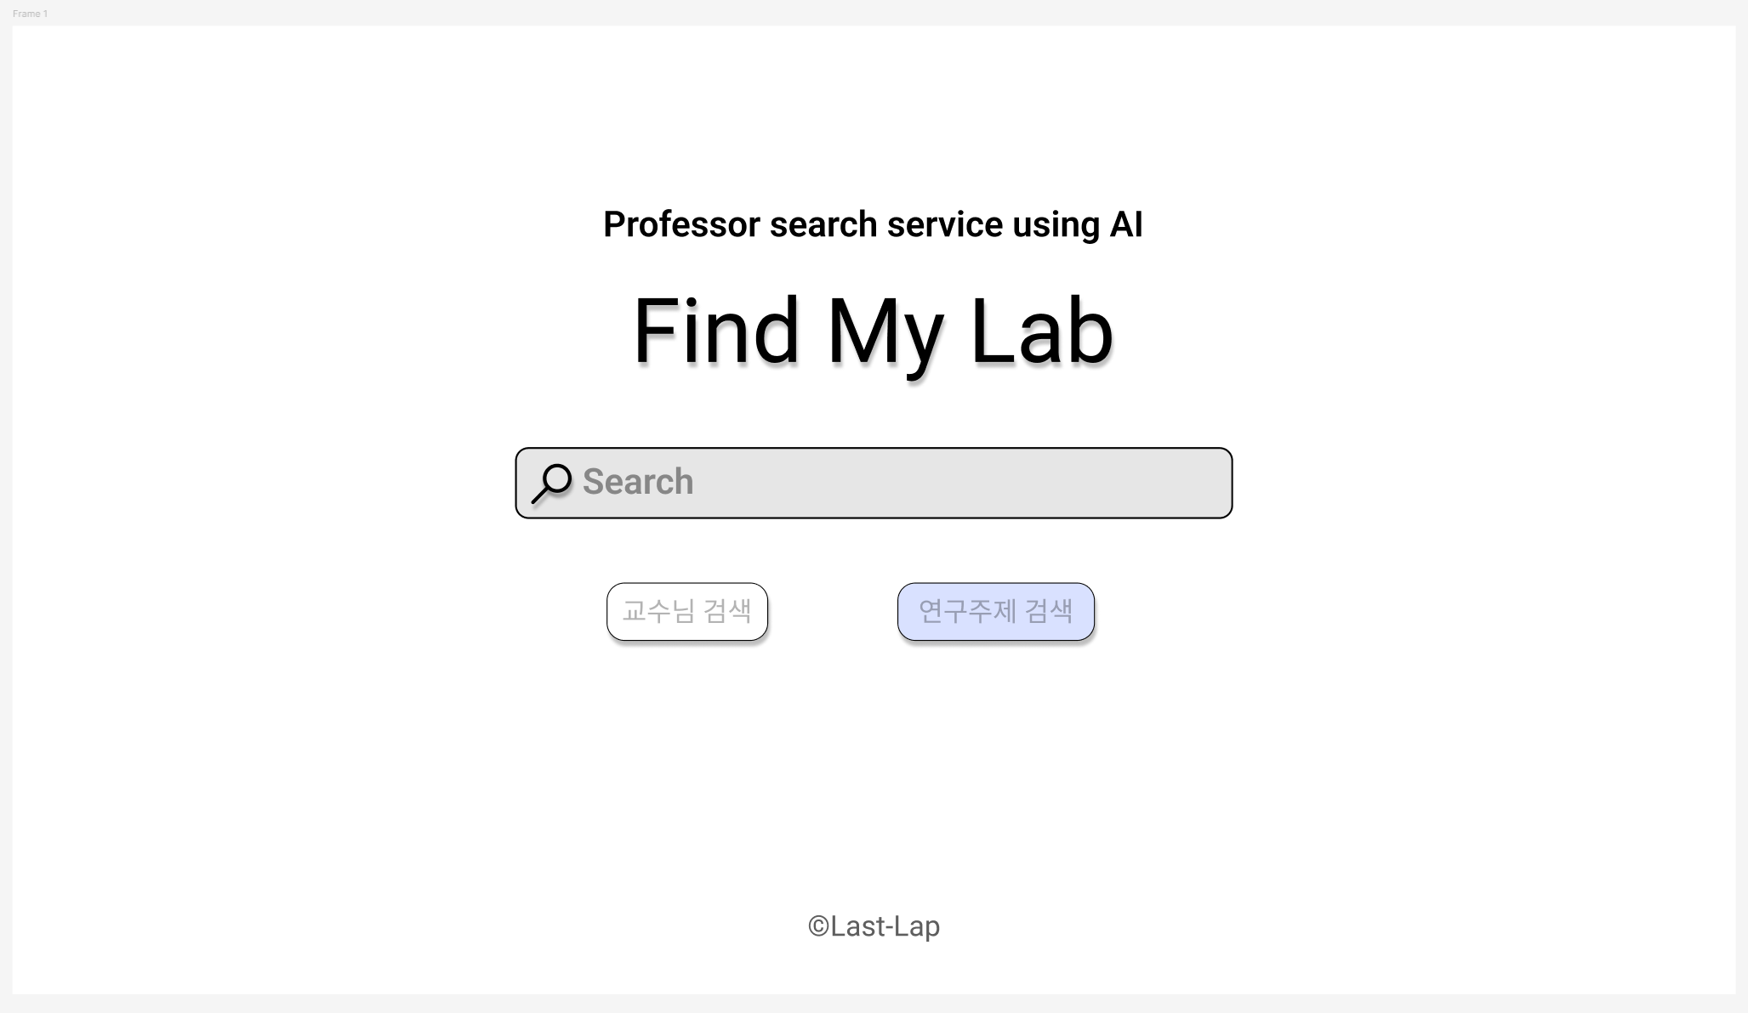
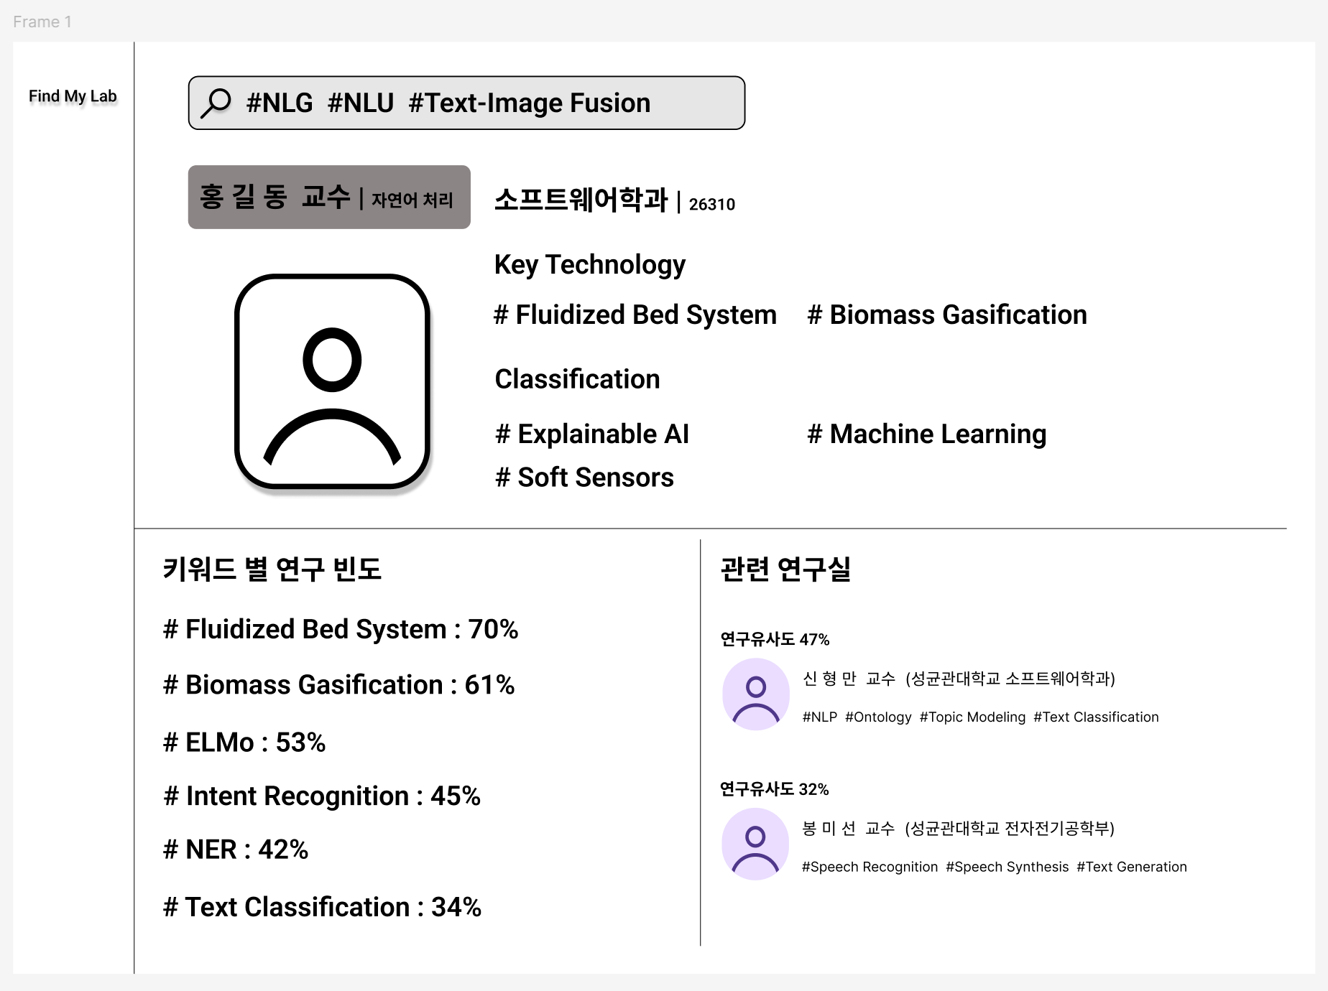
UX/UI
2024-Fall Capstone Design Project
Team J (Last Lap) 김현진 송민석 장민석 조재희
Notes:
First, I’ll explain the overall functioning of our application. If you perform a Research Topic Search on the Search Page, you’ll be directed to the Search Results Page. ## From there, if you click on a lab in the search results or conduct a Professor Search, you’ll be taken to the Lab Introduction Page for that specific lab. ## On the Lab Introduction Page, if you click on a research keyword, it will take you to a Search Results Page for that keyword. ## Likewise, if you click on a similar lab, you’ll be directed to the Lab Introduction Page for that lab.

Slide 5
UX/UI – Search Page
Search Bar
Change
Search Mode
2024-Fall Capstone Design Project
Team J (Last Lap) 김현진 송민석 장민석 조재희
Notes:
In the search bar, users can search by typing in a professor or research topic. Below that, there is a button to change the search mode. In the case of "Professor Search," if users enter a professor's name, users will be taken to the professor's Lab Introduction Page. In the case of "Research Topic Search," if users enter research topics, users will be taken to a page recommending labs in that field of study.

Slide 6
UX/UI – Search Result Page
List of Recommended Lab
- Professor
- Department
- Main Research Keywords
2024-Fall Capstone Design Project
Team J (Last Lap) 김현진 송민석 장민석 조재희
Notes:
The Search Results Page recommends labs that are conducting research most similar to the keywords searched using SBERT, sorted by similarity. For each lab, the professor, department, and main research keywords of the lab are briefly introduced. In addition, clicking on the lab will take users to the Lab Introduction Page.

Slide 7
UX/UI – Lab Introduction Page
Laboratory Key Information
Study frequency by keyword
Similar laboratory recommendations
2024-Fall Capstone Design Project
Team J (Last Lap) 김현진 송민석 장민석 조재희
Notes:
Next, Lab Introduction Page.
First, at the top, we have the introduction section, which provides an overview of the professor and the lab. In this section, users can quickly see the lab's primary research areas.
Next, we have a screen that visually presents the research frequency by keyword. Professors conduct research on various topics, and their areas of focus often change over time. To capture this evolution, we calculate research frequency by assigning higher weights to more recent research topics, and we visualize the proportions of the lab’s primary research areas. This helps students easily understand the professor’s current research trends.
Lastly, there is the similar labs recommendation section. Students may be more interested in finding labs related to their research interests rather than focusing on a particular professor. To address this, we have added a feature that recommends other labs with similar research focuses. For example, if a user is currently interested in a particular lab, they can see a list of labs with similar focuses, and by clicking on any recommended lab, they can go directly to its detailed information.

Slide 8

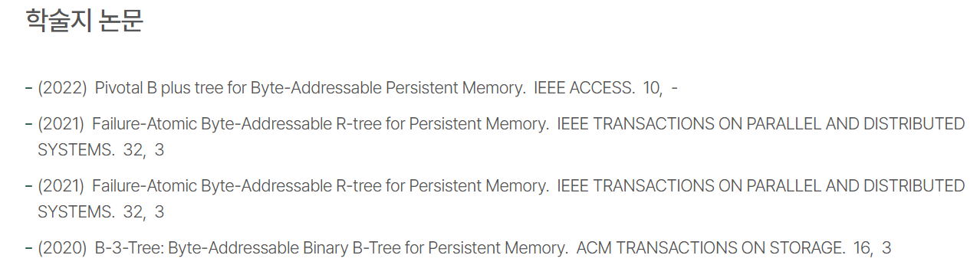
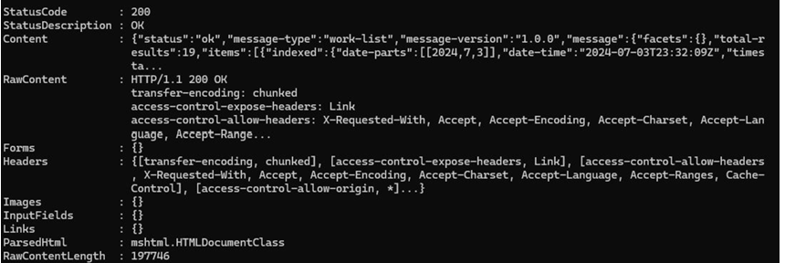
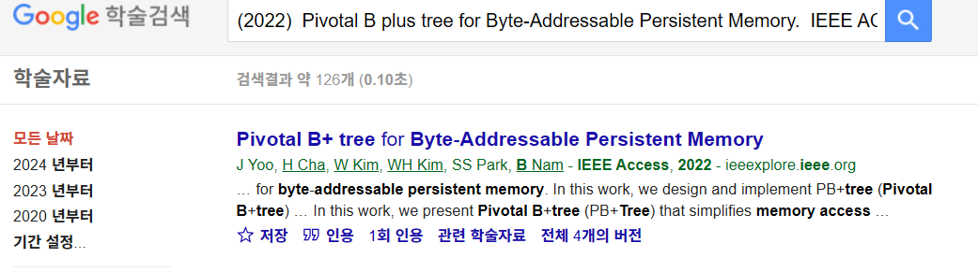
Backend – Abstract Extractor
[Crossref API]
2024-Fall Capstone Design Project
Team J (Last Lap) 김현진 송민석 장민석 조재희
Notes:
Now, let me introduce the backend implementation of this project. The first step in this project is collecting abstracts of the professors' research papers. To retrieve the papers' DOIs, that links to the webpages where each paper is hosted, we identified two main cases. The first case involves professors who have an ORCID, and the second case those who do not.
For professors with an ORCID, we were able to use the Crossref API to retrieve a list of their published papers. But, for professors without an ORCID, gathering a complete list of their papers proved challenging. As a workaround, we referred to the list of published papers on Sungkyunkwan University's website. Then, using Google Scholar, we searched for each paper’s DOI.

Slide 9

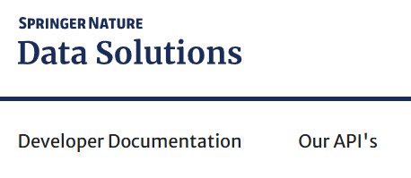

Backend – Abstract Extractor
2024-Fall Capstone Design Project
Team J (Last Lap) 김현진 송민석 장민석 조재희
Notes:
Next, let’s discuss how we extract abstracts from various research sites. Some platforms, like Springer Nature, provide APIs that allow us to easily retrieve abstracts. However, for sites that lack an API or restrict API usage, like ACM, we employed Selenium and BeautifulSoup to collet the abstracts. Of cource, we adhere to each site's scraping regulations by checking their robots.txt file.

Slide 10
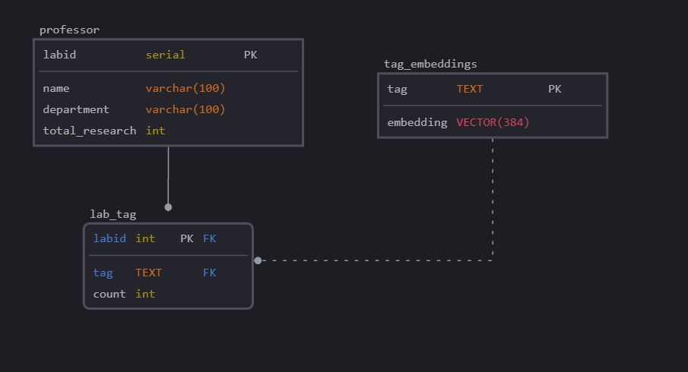
Backend – Database
2024-Fall Capstone Design Project
Team J (Last Lap) 김현진 송민석 장민석 조재희
Notes:
For our database, we chose PostgreSQL, using its pgvector extension to efficiently perform cosine similarity calculations. By storing embeddings for the labs’ abstracts, we can reduce computation time by only extracting embeddings for search queries and calculating their cosine similarity with the stored data.

Slide 11
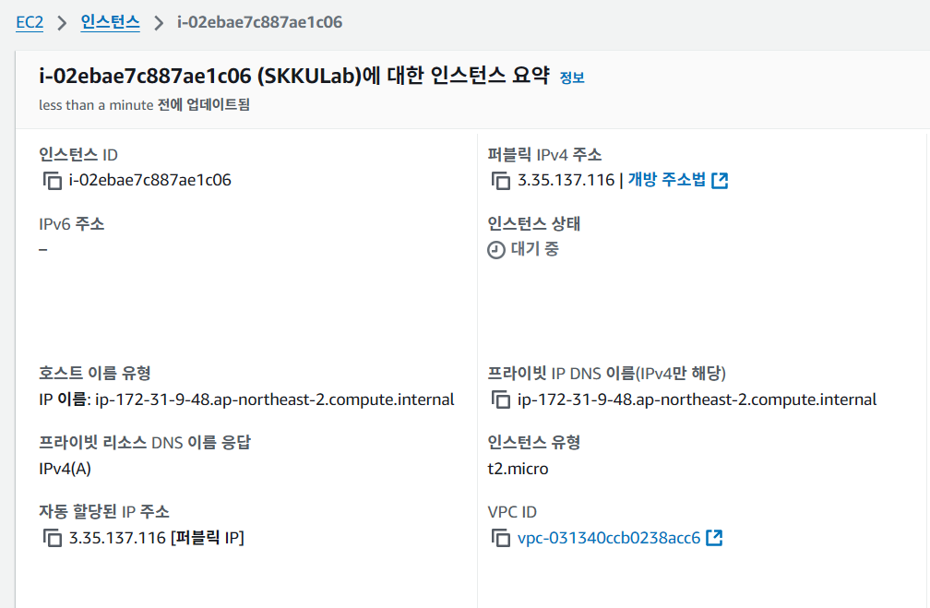
Backend – Restful server
2024-Fall Capstone Design Project
Team J (Last Lap) 김현진 송민석 장민석 조재희
Notes:
Lastly, we decided to set up the server on AWS. While vector calculations and embedding extraction could also be performed on this server, in the case of any performance issues on AWS, we plan to handle requests through the server and perform heavy tasks on a separate dedicated server or machine.

Slide 12

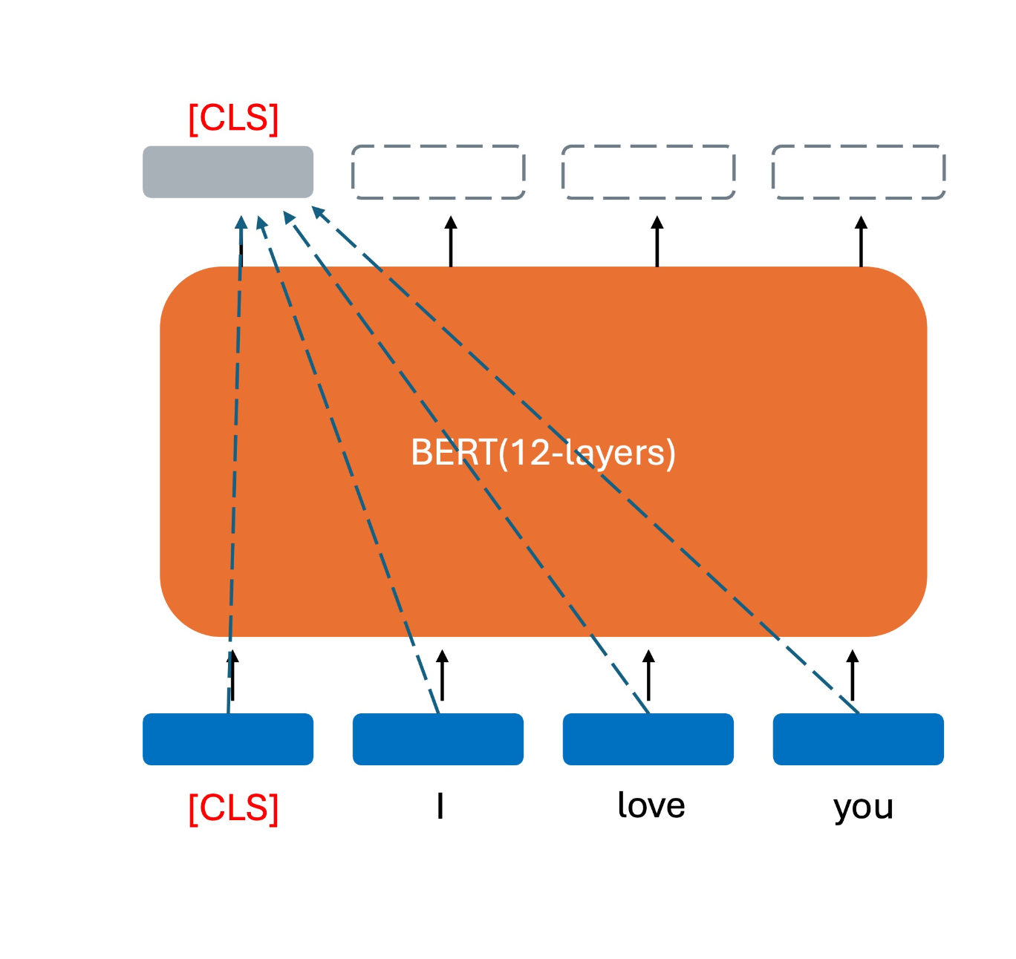
AI - SBERT
Wiki/Library
corpuses
: SBERT-bas-nli-v2
(u; v; |u-v|)
u
v
pooling
pooling
BERT
BERT
Sentence A
Sentence B
2024-Fall Capstone Design Project
Team J (Last Lap) 김현진 송민석 장민석 조재희
Notes:
Next, talk about AI model. We use a pretrained SBERT. This model has been pretrained on generic Wiki/Library corpuses and extensively trained on a broad range of open-source data. The SBERT-base-nli-v2 model from Hugging Face has been loaded, which is fine-tuned for semantic search through an NLI downstream task.

Slide 13
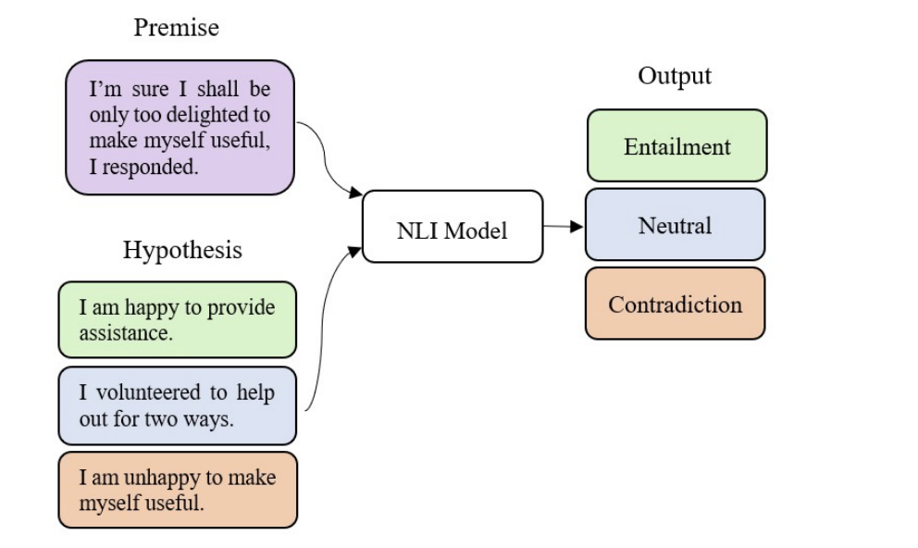
AI – NLI Task
NLI (Natural Language Inference)
Goal: understanding the relationships between sentences
2024-Fall Capstone Design Project
Team J (Last Lap) 김현진 송민석 장민석 조재희
Notes:
NLI, Natural Language Inference, is a task that classifies the relationship between a hypothesis and a premise as either entailment, contradiction, or neutral. By performing this classification, the model improves its ability to understand and infer textual information, thereby enhancing its capability to understand context effectively.

Slide 14




AI - Goal
similarity
results
search words
abstracts
paper
lab
2024-Fall Capstone Design Project
Team J (Last Lap) 김현진 송민석 장민석 조재희
Notes:
Our task focuses on calculating the similarity between paper abstracts and keywords to accurately identify papers and labs with high relevance.

Slide 15
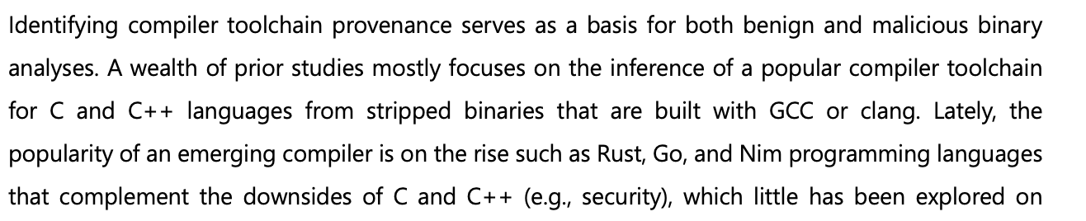
AI - Experiment
Compiler toolchain provenance
BERT-based system
Toolchain classification
Binary code similarity detection
Machine learning
positive
:
:
Dialogue-specific pre-training task
Encoder-decoder transformer
AI dialogue systems
Language understanding and generation
target abstract
semi negative
( same domain but different )
2024-Fall Capstone Design Project
Team J (Last Lap) 김현진 송민석 장민석 조재희
Notes:
The current experiment involved calculating the similarity between the target abstract and a positive pair keyword and a negative pair keyword. For positive pairs, keywords extracted directly from the paper were used, generated through GPT prompting.
This positive pair keywords are the example of search keywords
For negative pairs, keywords were chosen from papers within the same domain (AI) but covering different topics, to avoid overly simple or difficult samples and select challenging yet relevant keywords.

Slide 16
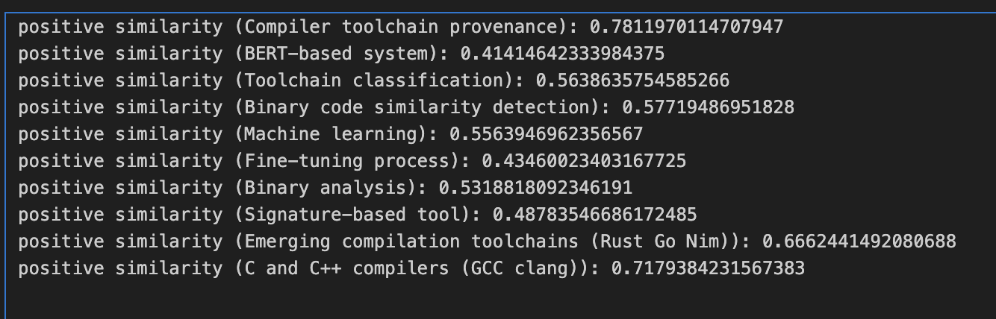
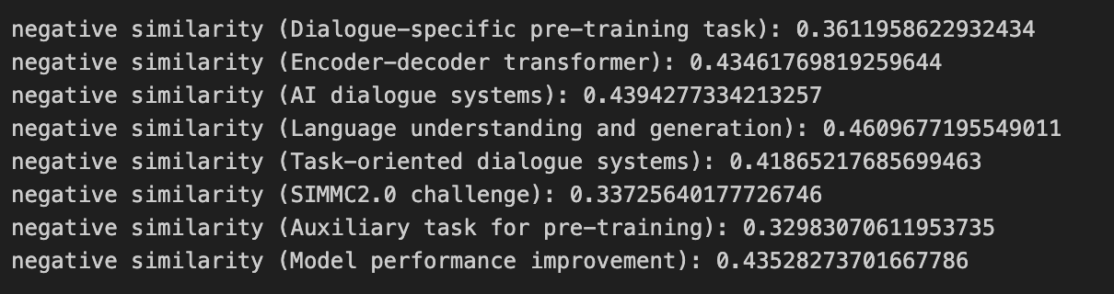
AI - Experiment
positive
0.5
(almost)
negative
0.5
2024-Fall Capstone Design Project
Team J (Last Lap) 김현진 송민석 장민석 조재희
Notes:
Experimental results show that, even with the pretrained model, the similarity for positive pairs is noticeably higher than for negative pairs. However, some keywords show a similarity score slightly below 0.5, which raises the question of how to approach (unsupervised) fine-tuning to address these cases effectively.

Slide 17
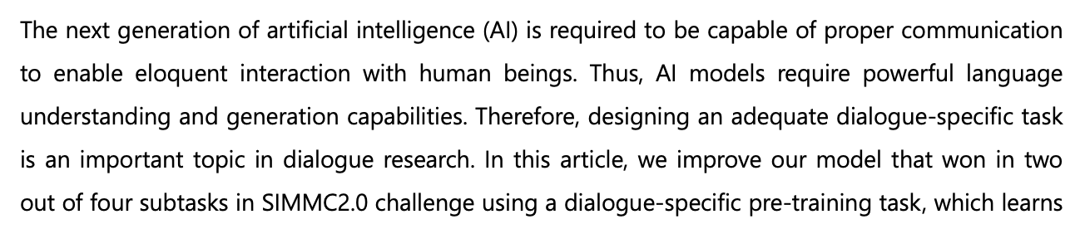
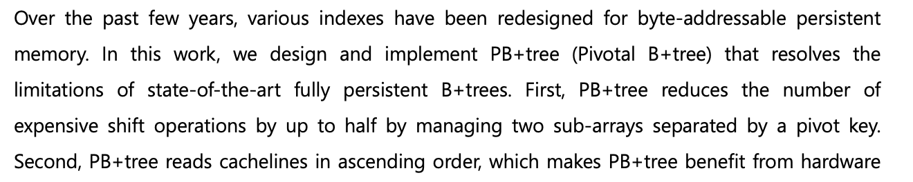
AI - Experiment
positive
Compiler toolchain provenance
BERT-based system
Toolchain classification
Binary code similarity detection
Machine learning
target words
semi - negative
negative
2024-Fall Capstone Design Project
Team J (Last Lap) 김현진 송민석 장민석 조재희
Notes:
The second experiment involves comparing the similarity between a keyword’s positive paragraph (abstract) and its negative paragraph (abstract).
Similar to the previous experiment setup, we also examined the relationship with semi-negative paragraphs and conducted additional comparisons with completely negative paragraphs.

Slide 18
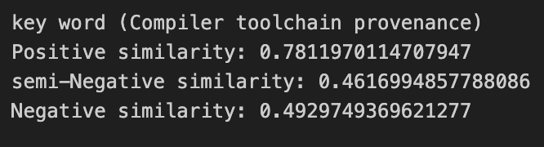
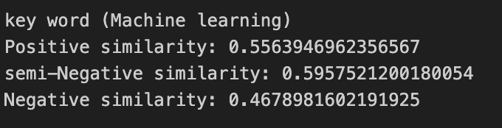
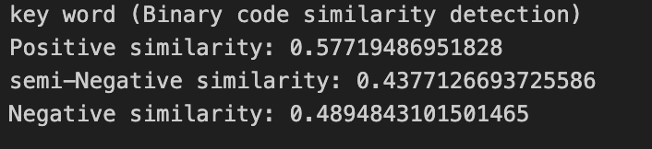
AI - Experiment
clear
domain specific
ambiguous
generic words
2024-Fall Capstone Design Project
Team J (Last Lap) 김현진 송민석 장민석 조재희
Notes:
The results indicate that the model generally performs well in identifying keywords with clear differences between papers. However, it seems to struggle slightly with very general terms within the same field such as "Machine Learning". Still, when calculating similarity based on an aggregated embedding rather than individual keyword embeddings, this doesn’t seem to cause major issues. In fact, grouping terms with similar values into a hierarchical structure might allow for a model that can adjust the depth of search, potentially enhancing search precision.

Slide 19

AI – To do
compressive embedding of lab
2024-Fall Capstone Design Project
Team J (Last Lap) 김현진 송민석 장민석 조재희
Notes:
At this stage, it’s essential to model lab embeddings by effectively combining research paper abstracts into a compressed, informative representation to support accurate lab recommendations.

Slide 20
Q & A
2024-Fall Capstone Design Project
Team J (Last Lap) 김현진 송민석 장민석 조재희

